Slide 1
Machine Learning Classification and Clustering
Nilkamal More
Department of Information Technology, FCRIT, Nerul

Slide 2
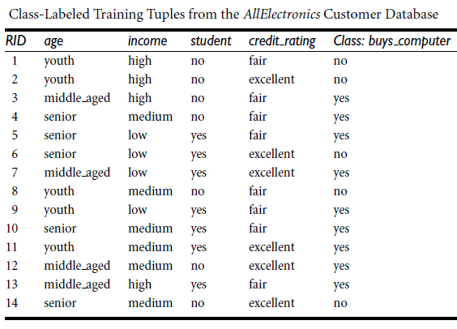

Slide 3

Example
Classification
The class label attribute, buys computer, has two distinct values, namely, {yes, no}; therefore, there are two distinct classes (i.e., m = 2).
Let class C1 correspond to yes and class C2 correspond to no.
There are nine tuples of class yes and five tuples of class no.
A (root) node N is created for the tuples in D.
To find the splitting criterion for these tuples, we must compute the information gain of each attribute.
We first compute the expected information needed to classify a tuple in D

Slide 4



Example
Classification
Next, we need to compute the expected information requirement for each attribute.
Let’s start with the attribute age.
We need to look at the distribution of yes and no tuples for each category of age.
For the age
category “youth,” there are two yes tuples and three no tuples.
category “middle aged,” there are four yes tuples and zero no tuples.
category “senior,” there are three yes tuples and two no tuples.
Compute the expected information needed to classify a tuple in D if the tuples are partitioned according to age is

Slide 5
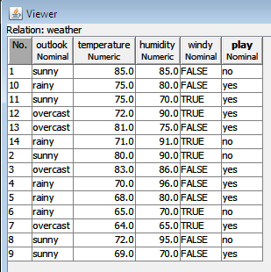

Slide 6
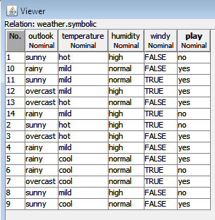

Slide 7
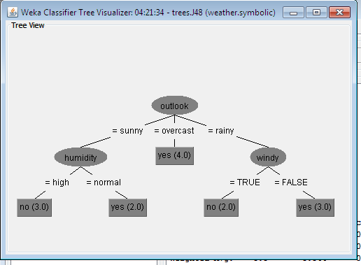

Slide 8
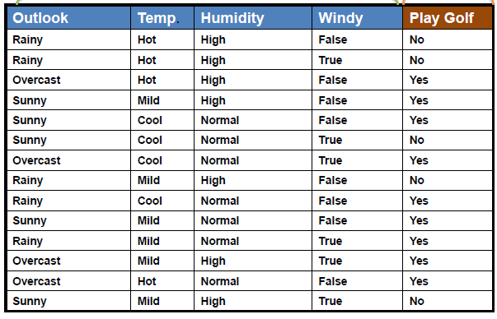

Slide 9
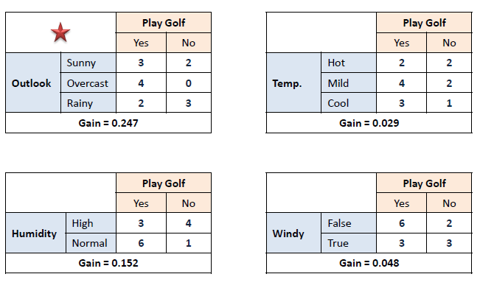
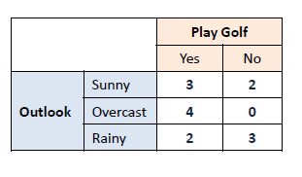
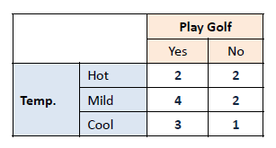
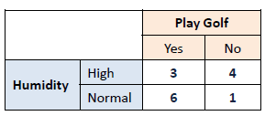
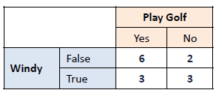

Slide 10
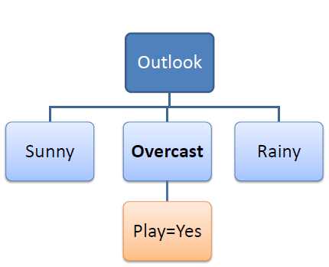
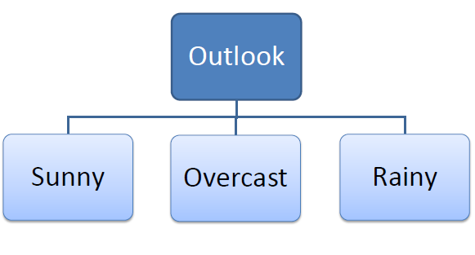

Slide 11
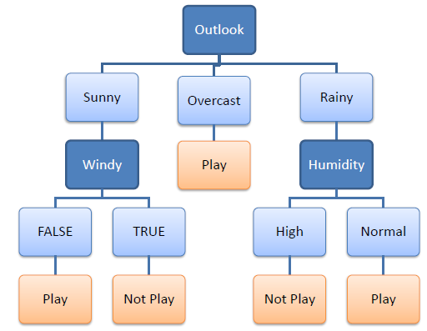
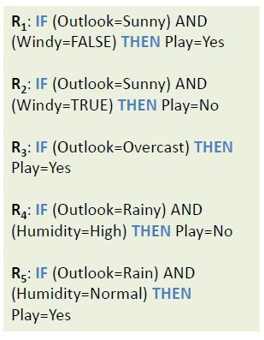

Slide 12
Quiz Time !!!
What is the complexity of decision tree?
As the data structure is tree the complexity is in order of log, but the cost of designing tree must be included.

Slide 13
Basic Concepts
Classification
Bayesian classifiers are statistical classifiers.
They can predict class membership probabilities such as the probability that a given tuple belongs to a particular class.
Bayesian classification is based on Bayes’ theorem.
Naive Bayesian classifiers assume that the effect of an attribute value on a given class is independent of the values of the other attributes.
This assumption is called class conditional independence. It is made to simplify the computations involved and, in this sense, is considered “naive.”
Notes:
Figure: A system is described by the partial descriptions in terms of the models (formal or semi formal).
From model, either execution or by other means abstract test cases can be derived. Abstract test cases are portable to any implementation platform to generate concrete test cases.
Concrete test cases are used to test implementation of the systems.
Model based testing promotes design driven testing.
This leads to early planning and design of test cases in the development cycle.
As concurrency is the property of he system, concurrency testing may be planned and designed early in the development cycle with the help of models.
UML designs are one of the source of concurrency information at the design level.
With recent trend towards Model Driven Architecture (MDA) \cite{Poole2001}, the choice of UML models is natural source for concurrency information at the design level.
Image source -- http://en.wikipedia.org/wiki/Model-based_testing

Slide 14

Bayes’ Theorem
Classification
Let X be a data tuple.
In Bayesian terms, X is considered “evidence.”
As usual, it is described by measurements made on a set of n attributes.
Let H be some hypothesis such as that the data tuple X belongs to a specified class C.
For classification problems, we want to determine P(H|X), the probability that the hypothesis H holds given the “evidence” or observed data tuple X.
In other words, we are looking for the probability that tuple X belongs to class C, given that we know the attribute description of X.

Slide 15
Bayes’ Theorem
Classification
P(H|X) is the posterior probability, or a posteriori probability, of H conditioned on X.
For example, suppose our world of data tuples is confined to customers described by the attributes age and income, respectively, and that X is a 35-year-old customer with an income of $40,000.
Suppose that H is the hypothesis that our customer will buy a computer.
Then P(H|X) reflects the probability that customer X will buy a computer given that we know the customer’s age and income.
Notes:
Concurrent states : http://twu.seanho.com/11spr/cmpt166/uml/state.html
Concurrent activity : http://twu.seanho.com/11spr/cmpt166/uml/#sequence-diagrams

Slide 16
Bayes’ Theorem
Classification
In contrast, P(H) is the prior probability, or a priori probability, of H.
For our example, this is the probability that any given customer will buy a computer, regardless of age, income, or any other information, for that matter.
The posterior probability, P(H|X), is based on more information (e.g., customer information) than the prior probability, P(H), which is independent of X.
Similarly, P(X|H) is the posterior probability of X conditioned on H.
That is, it is the probability that a customer, X, is 35 years old and earns $40,000, given that we know the customer will buy a computer.
P(X) is the prior probability of X.
Using our example, it is the probability that a person from our set of customers is 35 years old and earns $40,000.

Slide 17

Classification
Naive Bayesian Classification
The naïve Bayesian classifier, or simple Bayesian classifier, works as follows:
Let D be a training set of tuples and their associated class labels. As usual, each tuple is represented by an n-dimensional attribute vector, X ={ x1, x2, : : : , xn}, depicting n measurements made on the tuple from n attributes, respectively, A1, A2, : : : , An.
Suppose that there are m classes, C1, C2, : : : , Cm. Given a tuple, X, the classifier will predict that X belongs to the class having the highest posterior probability, conditioned on X. That is, the na¨ıve Bayesian classifier predicts that tuple X belongs to the class Ci if and only if
17

Slide 18

Classification
Naïve Bayesian Classification
2. Thus, we maximize P(Ci|X). The class Ci for which P(Ci|X) is maximized is called the maximum posteriori hypothesis. By Bayes’ theorem
3. As P(X) is constant for all classes, only P(X|Ci)/P(Ci) needs to be maximized. If the class prior probabilities are not known, then it is commonly assumed that the classes are equally likely, that is, P(C1)= P(C2) =, …, = P(Cm), and we would therefore maximize P(X|Ci). Otherwise, we maximize P(X|Ci)P(Ci). Note that the class prior probabilities may be estimated by P(Ci) = |C_{i,D}|/|D|, where |C_{i,D}| is the number of training tuples of class Ci in D.
18

Slide 19
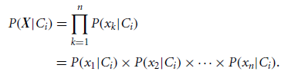
Naïve Bayesian Classification
Classification
Given data sets with many attributes, it would be extremely computationally expensive to compute P(X|Ci). To reduce computation in evaluating P(X|Ci), the na¨ıve assumption of class-conditional independence is made. This presumes that the attributes’ values are conditionally independent of one another, given the class label of the tuple (i.e., that there are no dependence relationships among the attributes). Thus,

Slide 20
Classification
Naïve Bayesian Classification
To predict the class label of X, P(X|Ci)P(Ci) is evaluated for each class Ci . The classifier predicts that the class label of tuple X is the class Ci if and only if
In other words, the predicted class label is the class Ci for which P(X|Ci)/P(Ci) is the maximum.

Slide 22
Example
Classification
The data tuples are described by the attributes age, income, student, and credit rating.
The class label attribute, buys computer, has two distinct values namely, {yes, no}).
Let C1 correspond to the class buys computer D yes and C2 correspond to buys computer D no. The tuple we wish to classify is

Slide 23



Example
Classification
We need to maximize P(X|Ci)P(Ci), for i=1, 2.
P(Ci), the prior probability of each class, can be computed based on the training tuples:

Slide 24

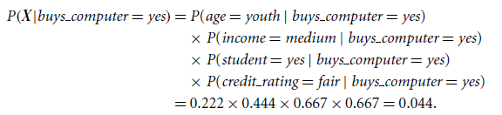

Example
Classification
Using these probabilities, we obtain
Similarly,
To find the class, Ci , that maximizes P(X|Ci)P(Ci), we compute

Slide 25
Naïve Bayes

Slide 26
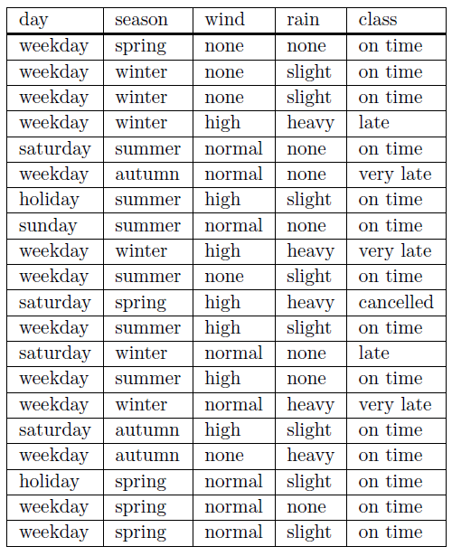
Figure 1 The Train Dataset
weekday | winter | high | heavy | ?????

Slide 27
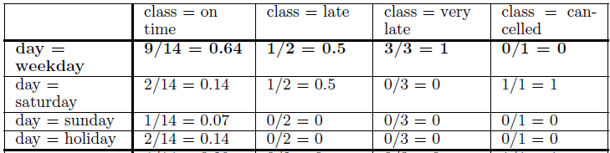
For the Train dataset

Slide 28
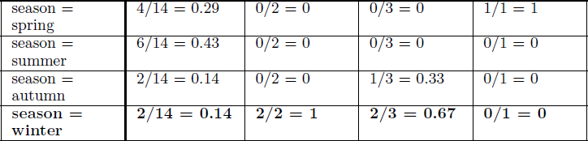



Slide 29





Slide 30
Features | CLASSIFICATION | CLUSTERING
Type of learning | Supervised | Unsupervised
Algorithms available | Naïve Bayesian,SVM | K-means,K-Medoid
Type of dataset | Labeled dataset | Unlabeled dataset
Application | Weather prediction, covid detection | Customer segmentation
Basic criteria | Information gain, gain ratio, gini index | Distance measures
Process | Classify an unknown sample | Group
Type of data | Discrete valued data | Numeric data
Accuracy measures | Confusion matrix,F1score ,precision, recall | Mean square error

Slide 31
Clustering

Slide 32
What is Clustering?
Cluster: a collection of data objects
Similar to one another within the same cluster
Dissimilar to the objects in other clusters
Cluster analysis
Grouping a set of data objects into clusters
Clustering is unsupervised classification: No predefined classes
Typical applications
To get insight into data distribution
As a preprocessing step for other algorithms

Slide 33
What Is a Good Clustering?
A good clustering method will produce clusters with
High intra-class similarity
Low inter-class similarity
The quality of a clustering result depends on both the similarity measure used by the method and its implementation

Slide 34
Requirements for Clustering in Data Mining
Scalability
Ability to deal with different types of attributes
Discovery of clusters with arbitrary shape
Minimal domain knowledge required to determine input parameters
Ability to deal with noise and outliers
Insensitivity to order of input records
Robustness wrt high dimensionality
Incorporation of user-specified constraints
Interpretability and usability

Slide 35
Major Clustering Approaches
Partitioning approach:
Construct various partitions and then evaluate them by some criterion, e.g., minimizing the sum of square errors
Typical methods: k-means, k-medoids.
Hierarchical approach:
Create a hierarchical decomposition of the set of data (or objects) using some criterion
Typical methods: Agglomerative, Diana, BIRCH
Density-based approach:
Based on connectivity and density functions
Typical methods: DBSACN, OPTICS

Slide 36
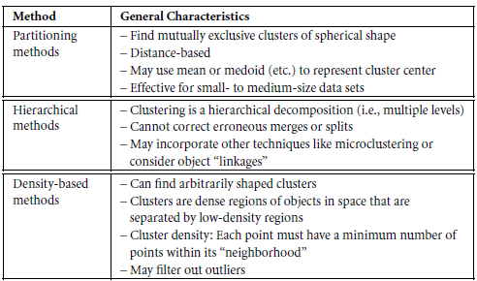

Slide 37
Partitioning Algorithms
Partitioning method: Construct a partition of a database D of n objects into a set of k clusters
Given a k, find a partition of k clusters that optimizes the chosen partitioning criterion
k-means (MacQueen, 1967): Each cluster is represented by the center of the cluster
k-medoids or PAM (Partition around medoids) (Kaufman & Rousseeuw, 1987): Each cluster is represented by one of the objects in the cluster

Slide 38
K-Means Clustering
Given k, the k-means algorithm is implemented in four steps:
Partition objects into k nonempty subsets
Compute seed points as the centroids of the clusters of the current partition (the centroid is the center, i.e., mean point, of the cluster)
Assign each object to the cluster with the nearest seed point
Go back to Step 2, stop when no more new assignment

Slide 39
K-Means Clustering (contd.)
Example
10
10
9
9
8
8
7
7
6
6
5
5
4
Assign each objects to most similar center
Update the cluster means
4
3
3
2
2
1
1
0
0
0
1
2
3
4
5
6
7
8
9
10
0
1
2
3
4
5
6
7
8
9
10
K=2
Arbitrarily choose K object as initial cluster center
39

Slide 40
K-means Example
For simplicity, 1-dimensional data and k=2.
Data: 1, 2, 5, 6, 7
K-means:
Randomly select 5 and 6 as initial centroids;
=> Two clusters {1, 2, 5} and {6,7};
mean C1=8/3 = 2.66 & mean C2=6.5
=> {1,2}, {5,6,7};
mean C1=1.5 & mean C2=6
=> No Change

Slide 41
Comments on the K-Means Method
Strengths
Relatively efficient: O(nkt), where n is # objects, k is # clusters, and t is # iterations. Normally, k, t << n.
Weaknesses
Applicable only when mean is defined (what about categorical data?)
Need to specify k, the number of clusters, in advance
Trouble with noisy data and outliers
Not suitable to discover clusters with non-convex shapes
Instead of taking the mean value of the object in a cluster as a reference point, medoids can be used, which is the most centrally located object in a cluster.

Slide 42
Example: K-Means
Figure: Initial Choice of Centroids
Figure: Objects For Clustering

Slide 43
Figure: Centroids After First Iterations
Figure: Centroids After First Two Iterations

Slide 44
Summary
Classification and prediction are two forms of data analysis that can be used to extract models describing important data classes or to predict future data trends.
Effective and scalable methods have been developed for decision trees induction, Naive Bayesian classification, Bayesian belief network, rule-based classifiers etc.
No single method has been found to be superior over all others for all data sets.

Slide 45
Books
Text Books:
1. Han, Kamber, "Data Mining Concepts and Techniques", Morgan Kaufmann 3nd Edition
2. P. N. Tan, M. Steinbach, Vipin Kumar, “Introduction to Data Mining”, Pearson Education
3. M. H. Dunham, Data Mining Techniques and Algorithms”, Prentice Hall-2000.

